Slide 1
Quantum GAN
5/8/2021

Slide 2
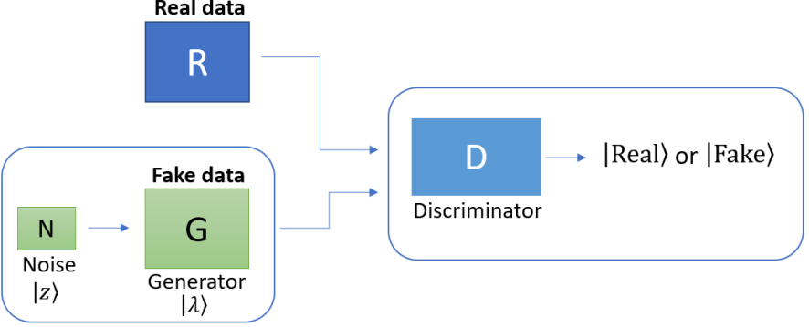
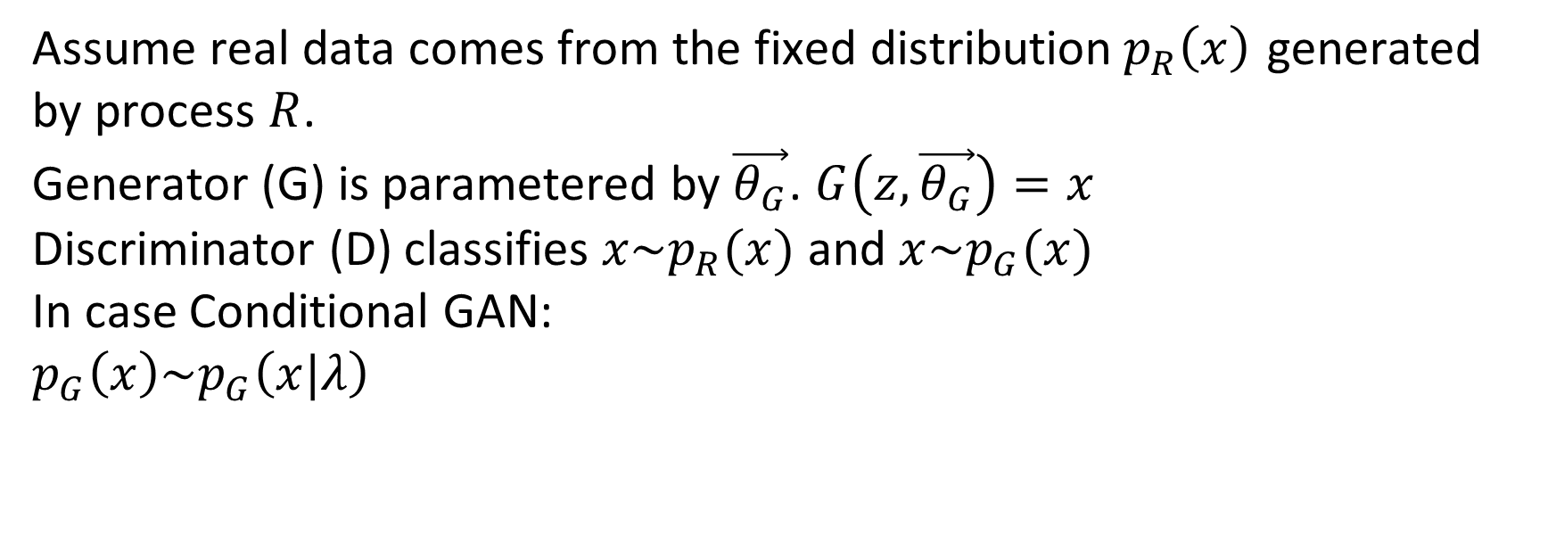
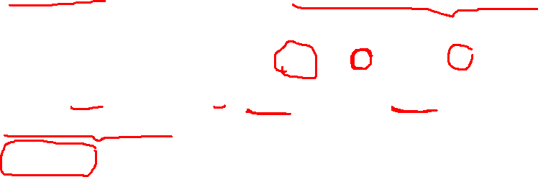
1. GAN
Assume real data comes from the fixed distribution$p_{R}\left(x\right)$ generated by process $R$.
Generator (G) is parametered by $\vec{θ_{G}}$. $G\left(z,\vec{θ_{G}}\right)=x$
Discriminator (D) classifies $x\sim p_{R}(x)$ and $x\sim p_{G}(x)$
In case Conditional GAN:
$$p_{G}\left(x\right)\sim p_{G}\left(x|λ\right)$$

Slide 3
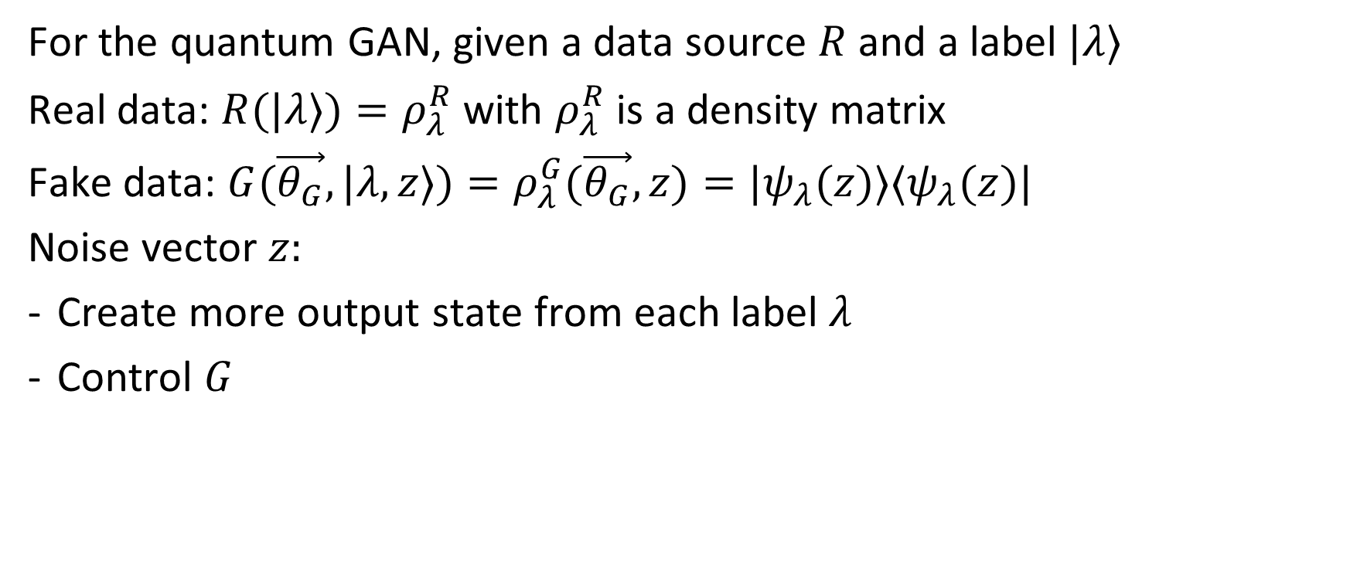
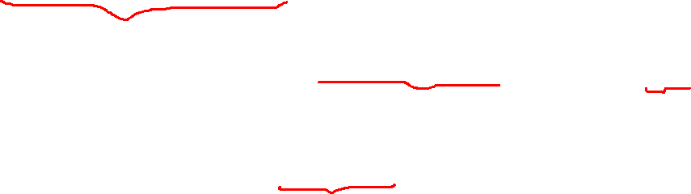
2. Quantum GAN
For the quantum GAN, given a data source $R$ and a label $|λ⟩$
Real data: $R(|λ⟩)=ρ_{λ}^{R}$ with $ρ_{λ}^{R}$ is a density matrix
Fake data: $G(\vec{θ_{G}},|λ,z⟩)=ρ_{λ}^{G}(\vec{θ_{G}},z)={|ψ}_{λ}(z)⟩⟨ψ_{λ}(z)|$
Noise vector $z:$
Create more output state from each label $λ$
Control $G$

Slide 4
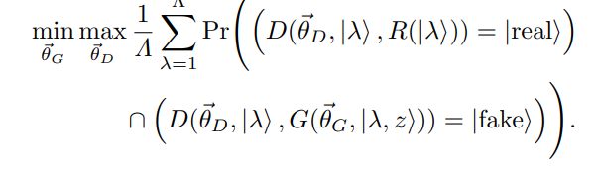
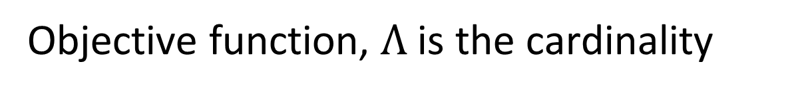

2. Quantum GAN
Objective function, $Λ$ is the cardinality

Slide 5
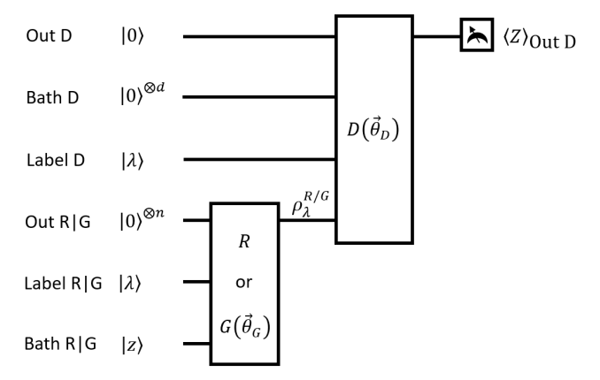
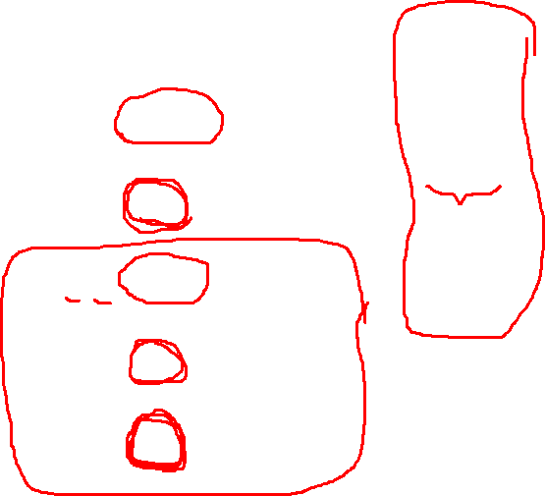
2. Quantum GAN
$$\left\langle Z\right\rangle ≡|real⟩⟨real|−|fake⟩⟨fake|$$

Slide 6
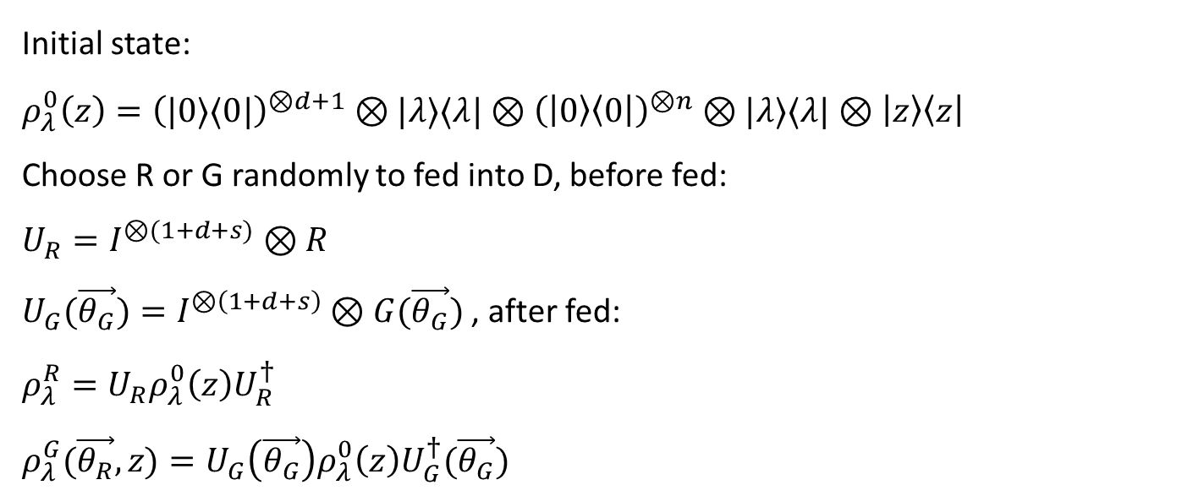
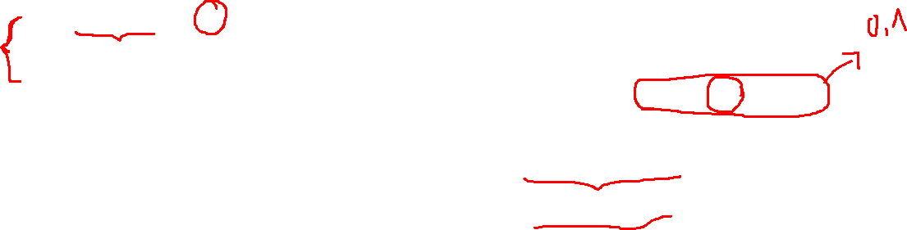
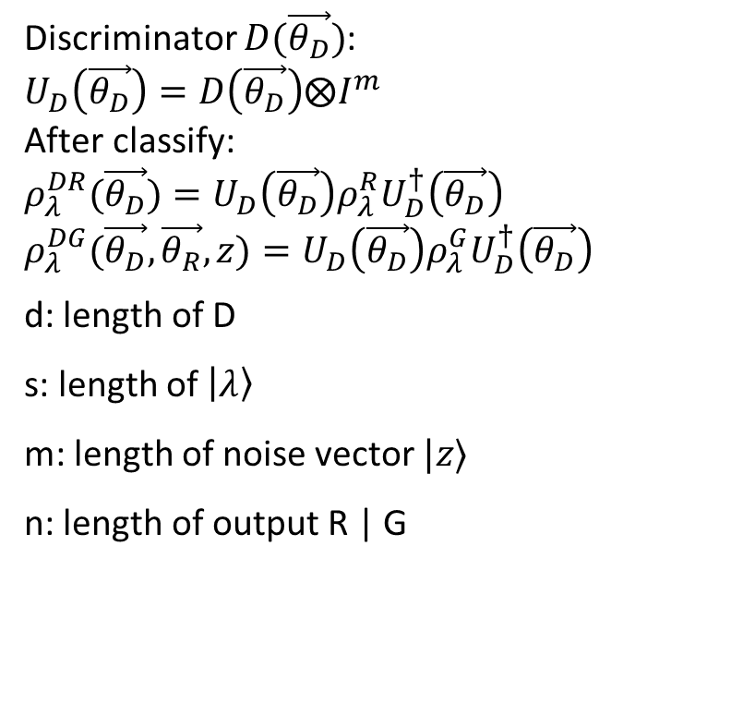
3. Quantum cost function
Initial state:
$ρ_{λ}^{0}\left(z\right)={\left(|0⟩⟨0|\right)}^{⊗d+1}⊗|λ⟩⟨λ|⊗{\left(\left|0\right\rangle \left\langle 0\right|\right)}^{⊗n}⊗|λ⟩⟨λ|⊗\left|z\right\rangle \left\langle z\right|$
Choose R or G randomly to fed into D, before fed:
$U_{R}=I^{⊗(1+d+s)}⊗R$
$U_{G}(\vec{θ_{G}})=I^{⊗\left(1+d+s\right)}⊗G(\vec{θ_{G}})$ , after fed:
$ρ_{λ}^{R}=U_{R}{ρ_{λ}^{0}\left(z\right)U}_{R}^{†}$
$ρ_{λ}^{G}(\vec{θ_{R}},z)=U_{G}\left(\vec{θ_{G}}\right)ρ_{λ}^{0}\left(z\right)U_{G}^{†}(\vec{θ_{G}})$
Discriminator $D(\vec{θ_{D}})$:
$U_{D}\left(\vec{θ_{D}}\right)=D\left(\vec{θ_{D}}\right)⨂I^{m}$
After classify:
$ρ_{λ}^{DR}(\vec{θ_{D}})=U_{D}\left(\vec{θ_{D}}\right)ρ_{λ}^{R}U_{D}^{†}\left(\vec{θ_{D}}\right)$ $ρ_{λ}^{DG}(\vec{θ_{D}},\vec{θ_{R}},z)=U_{D}\left(\vec{θ_{D}}\right)ρ_{λ}^{G}U_{D}^{†}\left(\vec{θ_{D}}\right)$
d: length of D
s: length of $\left|λ\right\rangle$
m: length of noise vector $|z⟩$
n: length of output R | G

Slide 7
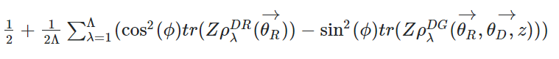
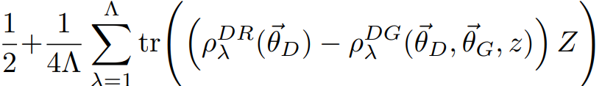

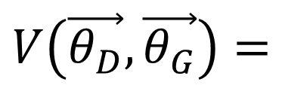
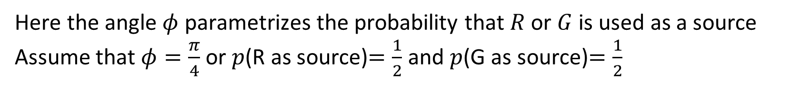
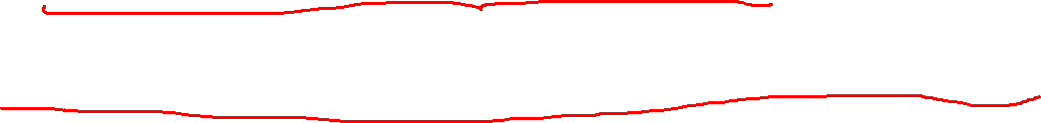
3. Quantum cost function
Cost function (transform from classical cost function of GAN):
$$V\left(\vec{θ_{D}},\vec{θ_{G}}\right)=$$
Here the angle $φ$ parametrizes the probability that $R$ or $G$ is used as a source
Assume that $φ=\frac{π}{4}$ or $p$(R as source)$=\frac{1}{2}$ and $p$(G as source)$=\frac{1}{2}$
$$V\left(\vec{θ_{D}},\vec{θ_{G}}\right)=$$

Slide 8

4. Training
We can train the quantum circuit by using gradient descent.
$${\vec{θ}}_{D}^{k+1}={\vec{θ}}_{D}^{k}+χ_{D}∇_{{\vec{θ}}_{D}}V$$
$${\vec{θ}}_{G}^{k+1}={\vec{θ}}_{G}^{k}−χ_{G}∇_{{\vec{θ}}_{G}}V$$

Slide 9
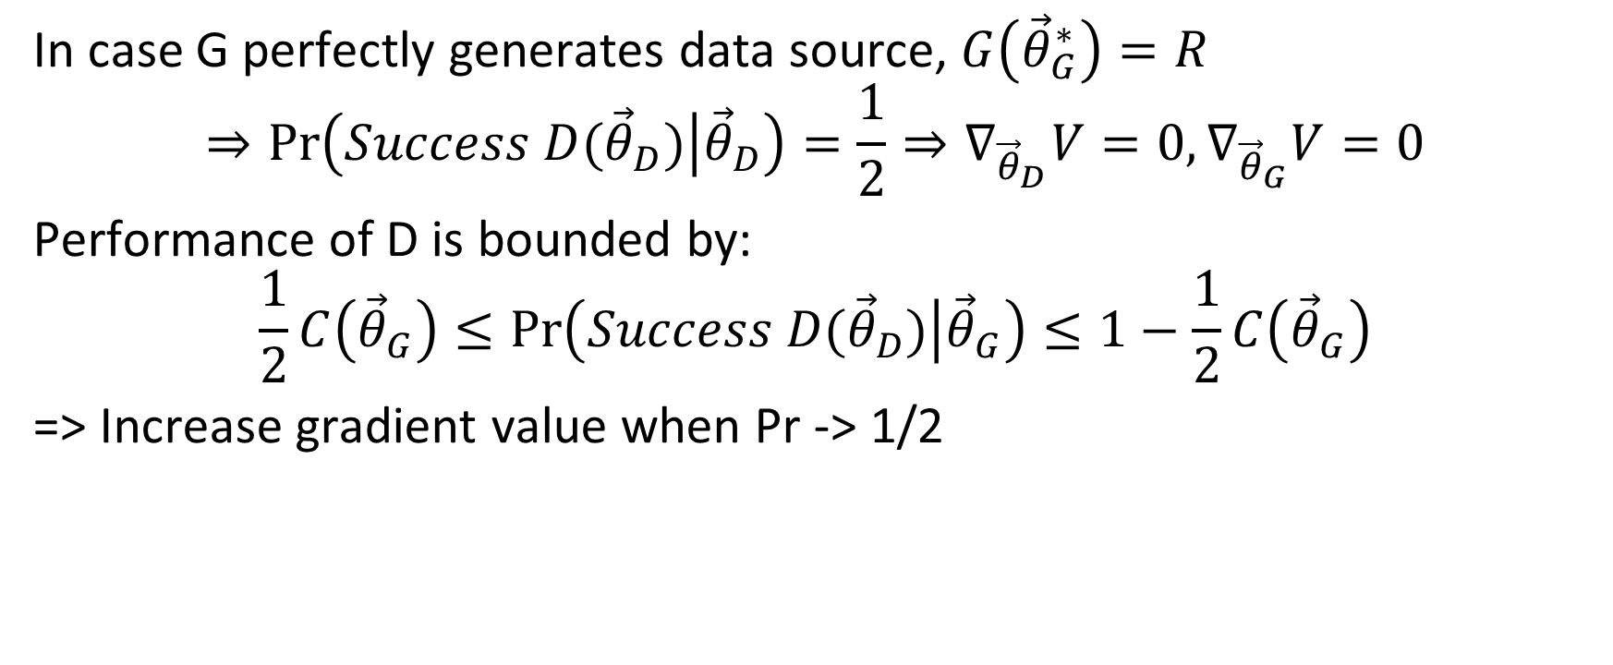
5. Limited cases
In case G perfectly generates data source, $G\left({\vec{θ}}_{G}^{∗}\right)=R$
$$⇒\operatorname{Pr}\left(Success D({\vec{θ}}_{D}) | {\vec{θ}}_{D}\right)=\frac{1}{2}⇒∇_{{\vec{θ}}_{D}}V=0,∇_{{\vec{θ}}_{G}}V=0$$
Performance of D is bounded by:
$$\frac{1}{2}C\left({\vec{θ}}_{G}\right)≤\operatorname{Pr}\left(Success D({\vec{θ}}_{D}) | {\vec{θ}}_{G}\right)≤1−\frac{1}{2}C\left({\vec{θ}}_{G}\right)$$
=> Increase gradient value when Pr -> 1/2

Slide 10
Example code
https://pennylane.ai/qml/demos/tutorial_QGAN.html

